Slide 1
RealSpend Desktop Overall Design concept
Lucky
Dec. 2012

Slide 2
Design principle
高内聚， 低耦合
KISS (Keep it simple and stupid)
Based on interface, not implementation

Slide 3
Name convention (Follow SAPUI5 convention)
Use Hungarian Notation for variables (at least vor API method parameters),
oSomeNumber for objects
mSomeMap for objects used as map
aSomeArray for arrays
bSomeBoolean for booleans
iSomeInteger for integer numbers
sSomeString for, well... strings
fSomeFunction for function pointers
Be positive“: „enabled“, not „disabled“; „editable“, not „readonly
Use jsdoc for comments, especial for the public API
Use _ for internal variable and function
Put the public API in the head of file

Slide 4
Main modules
View
Util
cfg
controller
Model
D3
SAPUI5
Data.js
jQuery

Slide 5
Model main tasks
Provide multiple language text information ( by ResourceModel), it will bind to sap.ui.core
Encapsulate and simplify the access to backend Odata
Provide convenient way for View to consume data
For SAPUI5 component, provide the JSONModel for TreeTable,
For D3, provide JSON format

Slide 6
Model internal classes
Note
Alert
ModelMng
TextMng
Model
HierMng
FuncParam
GeneralParam
ODataHelper

Slide 7
Model common access pattern
Asynchronous mode for performance
Rs.LoadStatus: NotStart, Pending, Succ,Fail
loadSpentDataByHierId: function( hierId, fnSucc, fnFail, context, cbData)
fnSucc
fnFail
Context
cbData

Slide 8
View design consideration
Reused code, data driven
Department, Expense, Project three view look similar, only different on data, so can use the same class rs.view.HierOverView extended from sap.ui.core.mvc.JSView
Use help class to manipulate view switch
PageMng:
switch between 4 tabs,
switch between TreeTable, Pie Map, TreeMap
NaviMng:
Overall view →Detial View →Line Item or Trend View
Extend current SAPUI5 to meet our requirement
TreeTable: Show group line, combine multiple column into one

Slide 9
View internal class/structure
Main
HierBaseView
NaviMng
OverView
HierOverView
PageMng
HierDetail
Internal
PageMng
LineItem
Trend

Slide 10
Configuration
Provide the enum constant value
Provide API to get current setting (View need use it to show informaiton, model use it to retrieve data)
Display dialog to let use change setting
Register and notify change event:
addChangeListener: function(cbFn, context, cbData)
In the call back, choose different action according to event
Only change the format, no need change model (such as just change color)
Inform model to reload data

Slide 11
Utils
rs.assert = jQuery.sap.assert;
rs.assertControl

Slide 12
Quality and tips
Use assert
Add comments
Understand JAVAScript , CSS, SAPUI5 first
Use JSDOC for document
Use jslint

Slide 13
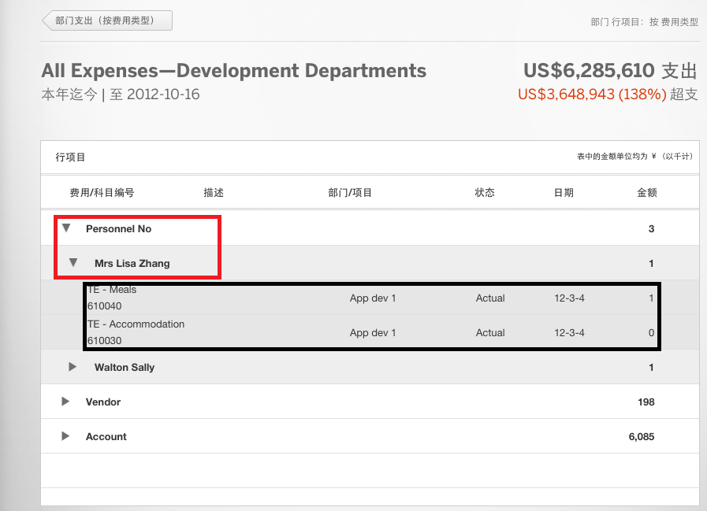
Summary Line Item and Line Item
GenericSummaryItemsByHierNodesAndPeriod
GenericLineItemsByHierNodesAndPeriod

Slide 14
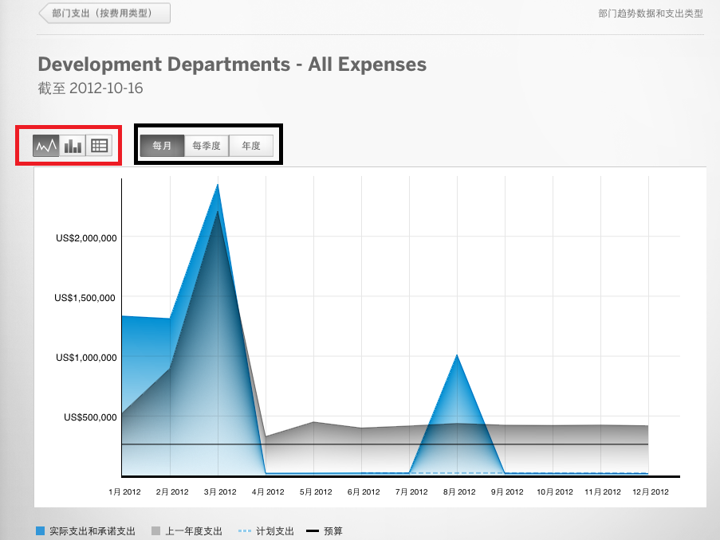
Trend

Slide 15
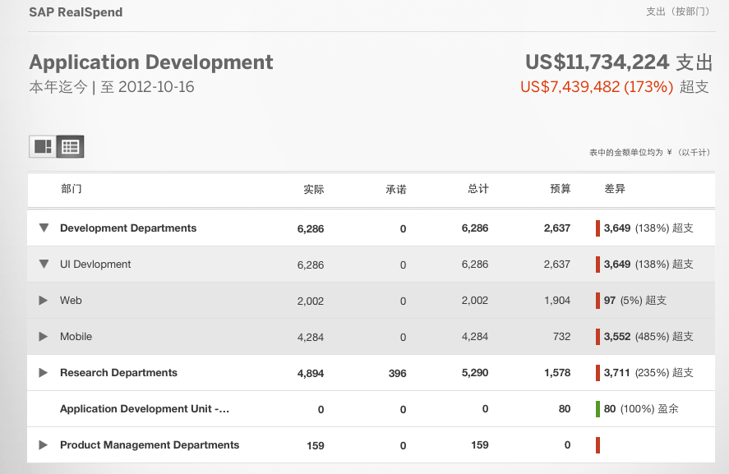
Spending Data: Overview
Here the herarchy structure is created by information from HierarchyNodes

Slide 16
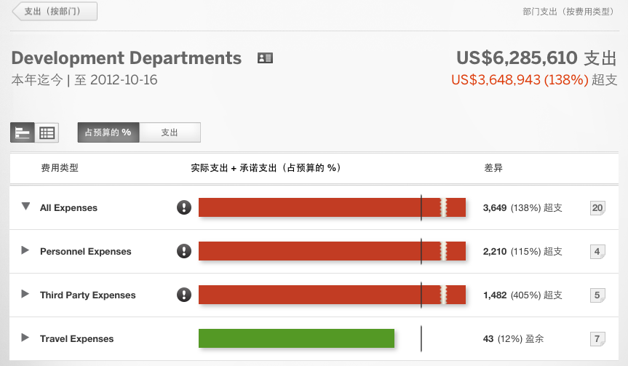
Spending Data: Detail, by percentage

Slide 17
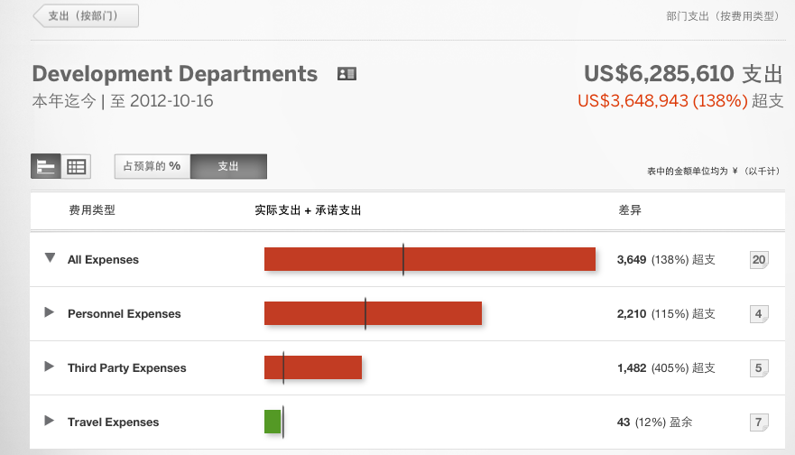
Spending Data: Detail, by spending

Slide 18
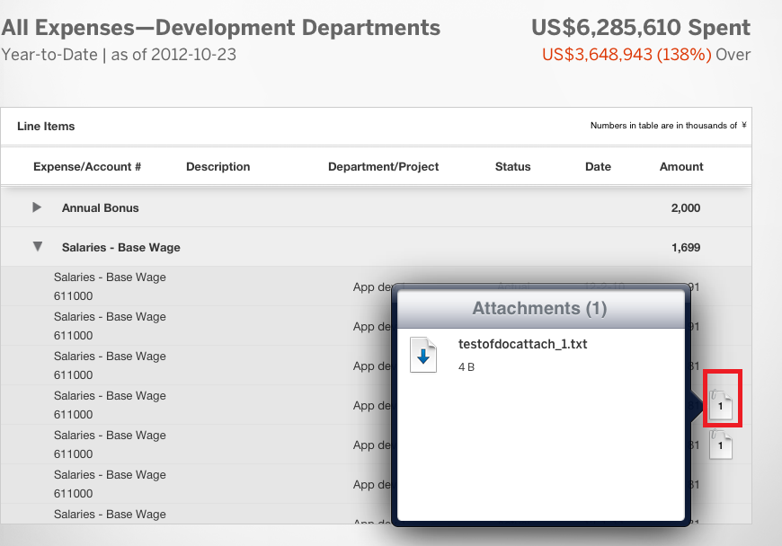
Attachment
The number of attachment is get from LineItem AttachmentNumber
File name and file size get by LineItems(xxx)/Attachments

Slide 19
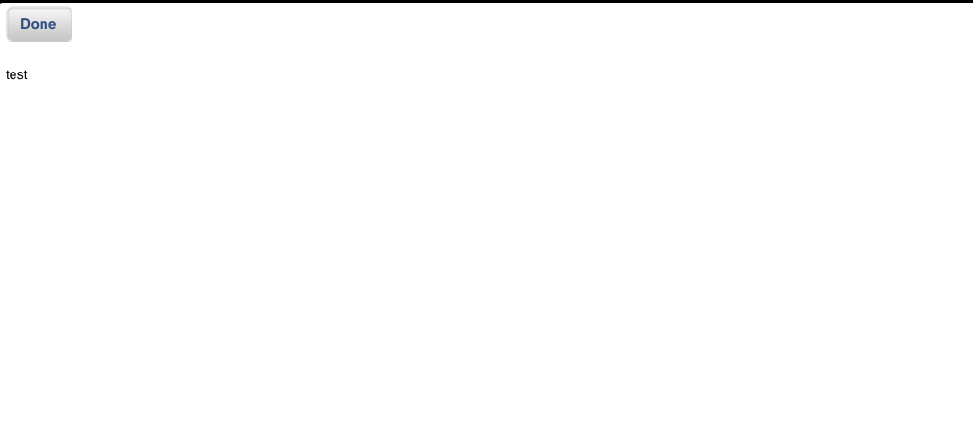
Attachment Content
1: By the attachment FileExtension know file type
2: By Attachments('FOL33000000000004EXT37000000000023')/Content can get the file content encoded by Base 64.

Slide 20
HierBaseView
columns : 1,
width : "100%",
widths:["100%"]
Provide common functions like
adjustTreeTableHeight
calculateMainContentWidthHeight
createContentLayout
MatrixLayout
row
MatrixLayoutCell

Slide 21

Overview head part
AbsoluteLayout headerData.setWidth('100%'); height : "55px"
oHeaderTextViewName
left:10 Top 0
_oSBBudgetSpend
left : "45%",
top : "0px"
oHeaderTextViewYearofDate
left:10 Top 30
Notes:
buttons : [ new sap.ui.commons.Button({
id : this.createId(this.BtnBudget),
text : "{i18n>Budget}",
textAlign:"Center",
width:"80px",
height:"40px"}),
new sap.ui.commons.Button({
id : this.createId(this.BtnSpend),
text : "{i18n>Spending}",
textAlign:"Center",
width:"80px",
height:"40px"})]});

Slide 22
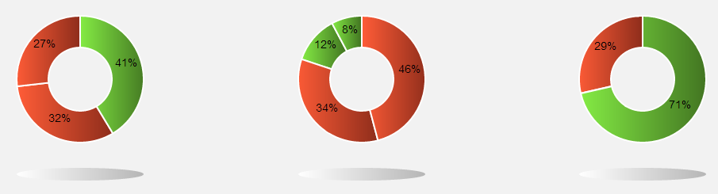
Overview main part
overViewMatrixCell-0-0 | overViewMatrixCell-0-1 | overViewMatrixCell-0-2
overViewMatrixCell-1-0 | overViewMatrixCell-1-1 | overViewMatrixCell-1-2
33%
34%
33%

Slide 23
InternalPageMng
Used to manage some page which
Show at the same position (such as the Treemap, treetable and pie+bar)
User can switch by the switchButton
Pre-requirement
It will add to a parent by call this.parent.addContent(htmlCtrol); so the parent must have such function
Now the HierOverivew and Trend call createContentLayout(), it create a sap.ui.commons.layout.MatrixLayout
How to switch
In begin, just set all the display as none
When set active, just show it like
id = "#"+ this.parent.getId()+'--page' + idx;
$(id).show('slow');

Slide 24

View/global createHeaderData()
oHeaderTextViewSpend2
Top:0, right:0
oHeaderTextViewSpend
Top:0 , right: 47~~60??
oHeaderTextViewName
Top: 0, left: 0
oHeaderTextViewDiff
R: 40, t: 38?
oHeaderTextViewLeftOrOver
T: 30, r:0
oHeaderTextViewYearofDate
Left:0, top: 30

Slide 25
HierOverView -- main
VerticalLayout
headPart
Width: 100%
switchToolbar
_oContentLayout
Width: 100%

Slide 26
HierOverview switch Toolbar
SegmentedButton
left : "0px",
top : "0px"
SegmentedButton
left : “210px", top : "0px"
TextView,
right:0, top:30
AbsoluteLayout height : "60px"

Slide 27
HierOverview treeMap/TreeTable/PieMap
Use InternalPageMng manage three views

Slide 28
HierDetail view

Slide 29
HierDetailView switch Toolbar
SegmentedButton
left : "0px",
top : "0px"
SegmentedButton
left : “210px", top : "0px"
TextView,
right:0, top:30
AbsoluteLayout height : "60px"

Slide 31
View design consideration (Overview screen)
Screen need update in following case
First time load data successful or failure
Setting changes, just need redraw the content (but data is same)
Time period changed:
First unbind the old data
Load new data from backend
After finished, just update the screen like the first one

Slide 32
View design consideration (Other screen)
Screen need update in following case
First time load data successful or failure (the old view is a clean view)
Load another view:
two case: Old view data is different with current view, same as current view (means first enter, then enter to parent view, then enter again)
First unload the old data
In call back, only do date update if it is for the current view
Setting changes, just need redraw the content (but data is same)
Time period changed: ( We will disable the TimePeriod if not in the over view screen)

